Slide 1

Gesture Controlled Wheelchair
Vishwaniketan's Institute of Management Entrepreneurship and Engineering Technology[iMEET], Khalapur
TEAM NUMBER- 02
Group member
1.Gaurav nemade
2.nikita patil
3.mayuresh bhopi
4.daksh maan
Under the guidance of
-Prof. Sandeep kate
-Trainer – Mr. Rohit Kumar

Slide 2

Agenda
Introduction
Project Overview
Technology used
Prototype (Screen Shot of Project)
Conclusion
References

Slide 3
Introduction
Wheelchair is best assitive device used by elders and disabled person
The driving and controlling of traditional wheelchair are much harder task
Our aim is to build a low cost and powerful wheelchair which helps the handicapped people to travel without dependings on others
Introducing a prototype to bring technology and economy parallel to each other

Slide 4
PROJECT OVERVIEW
Aim of project-To prepare a HAND GESTURES CONTROLLED WHEELCHAIR
For the physically disabled people who face difficulty in moving from one place to another in day today life.
These days joystick controlled wheel chair is available in the market whose cost range between Rs 80,000 to Rs 150,000. We have prepared this Hand Gesture Controlled Wheelchair in Rs 22,000 (approx.).

Slide 5
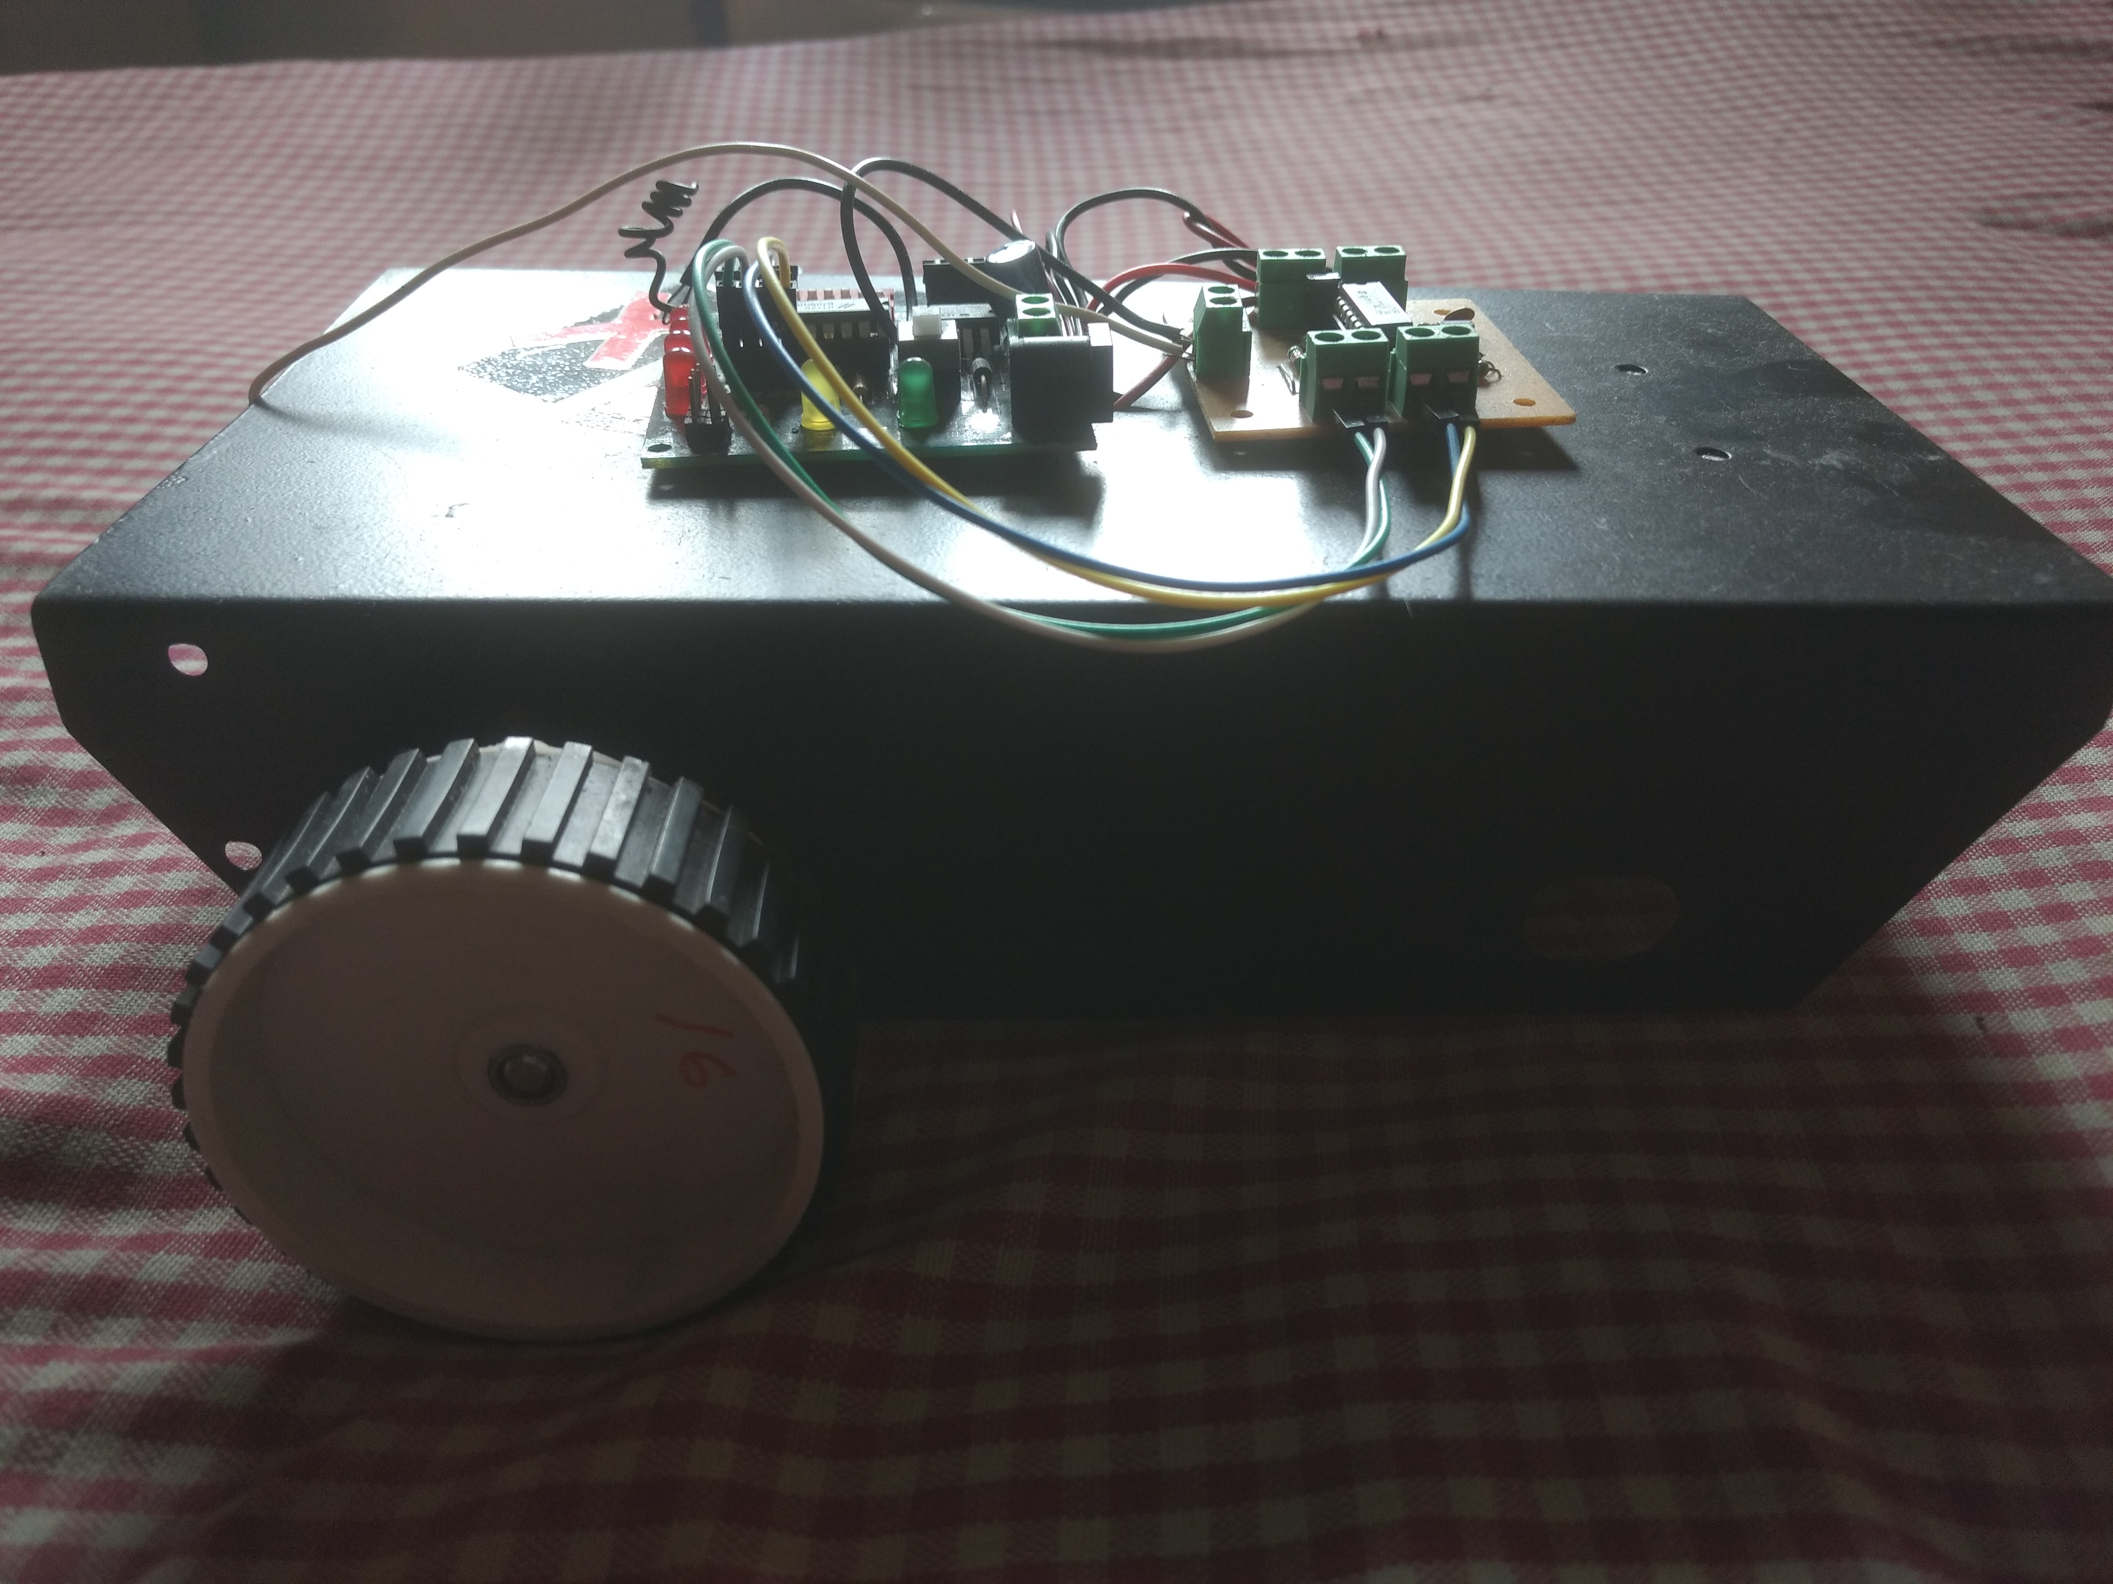
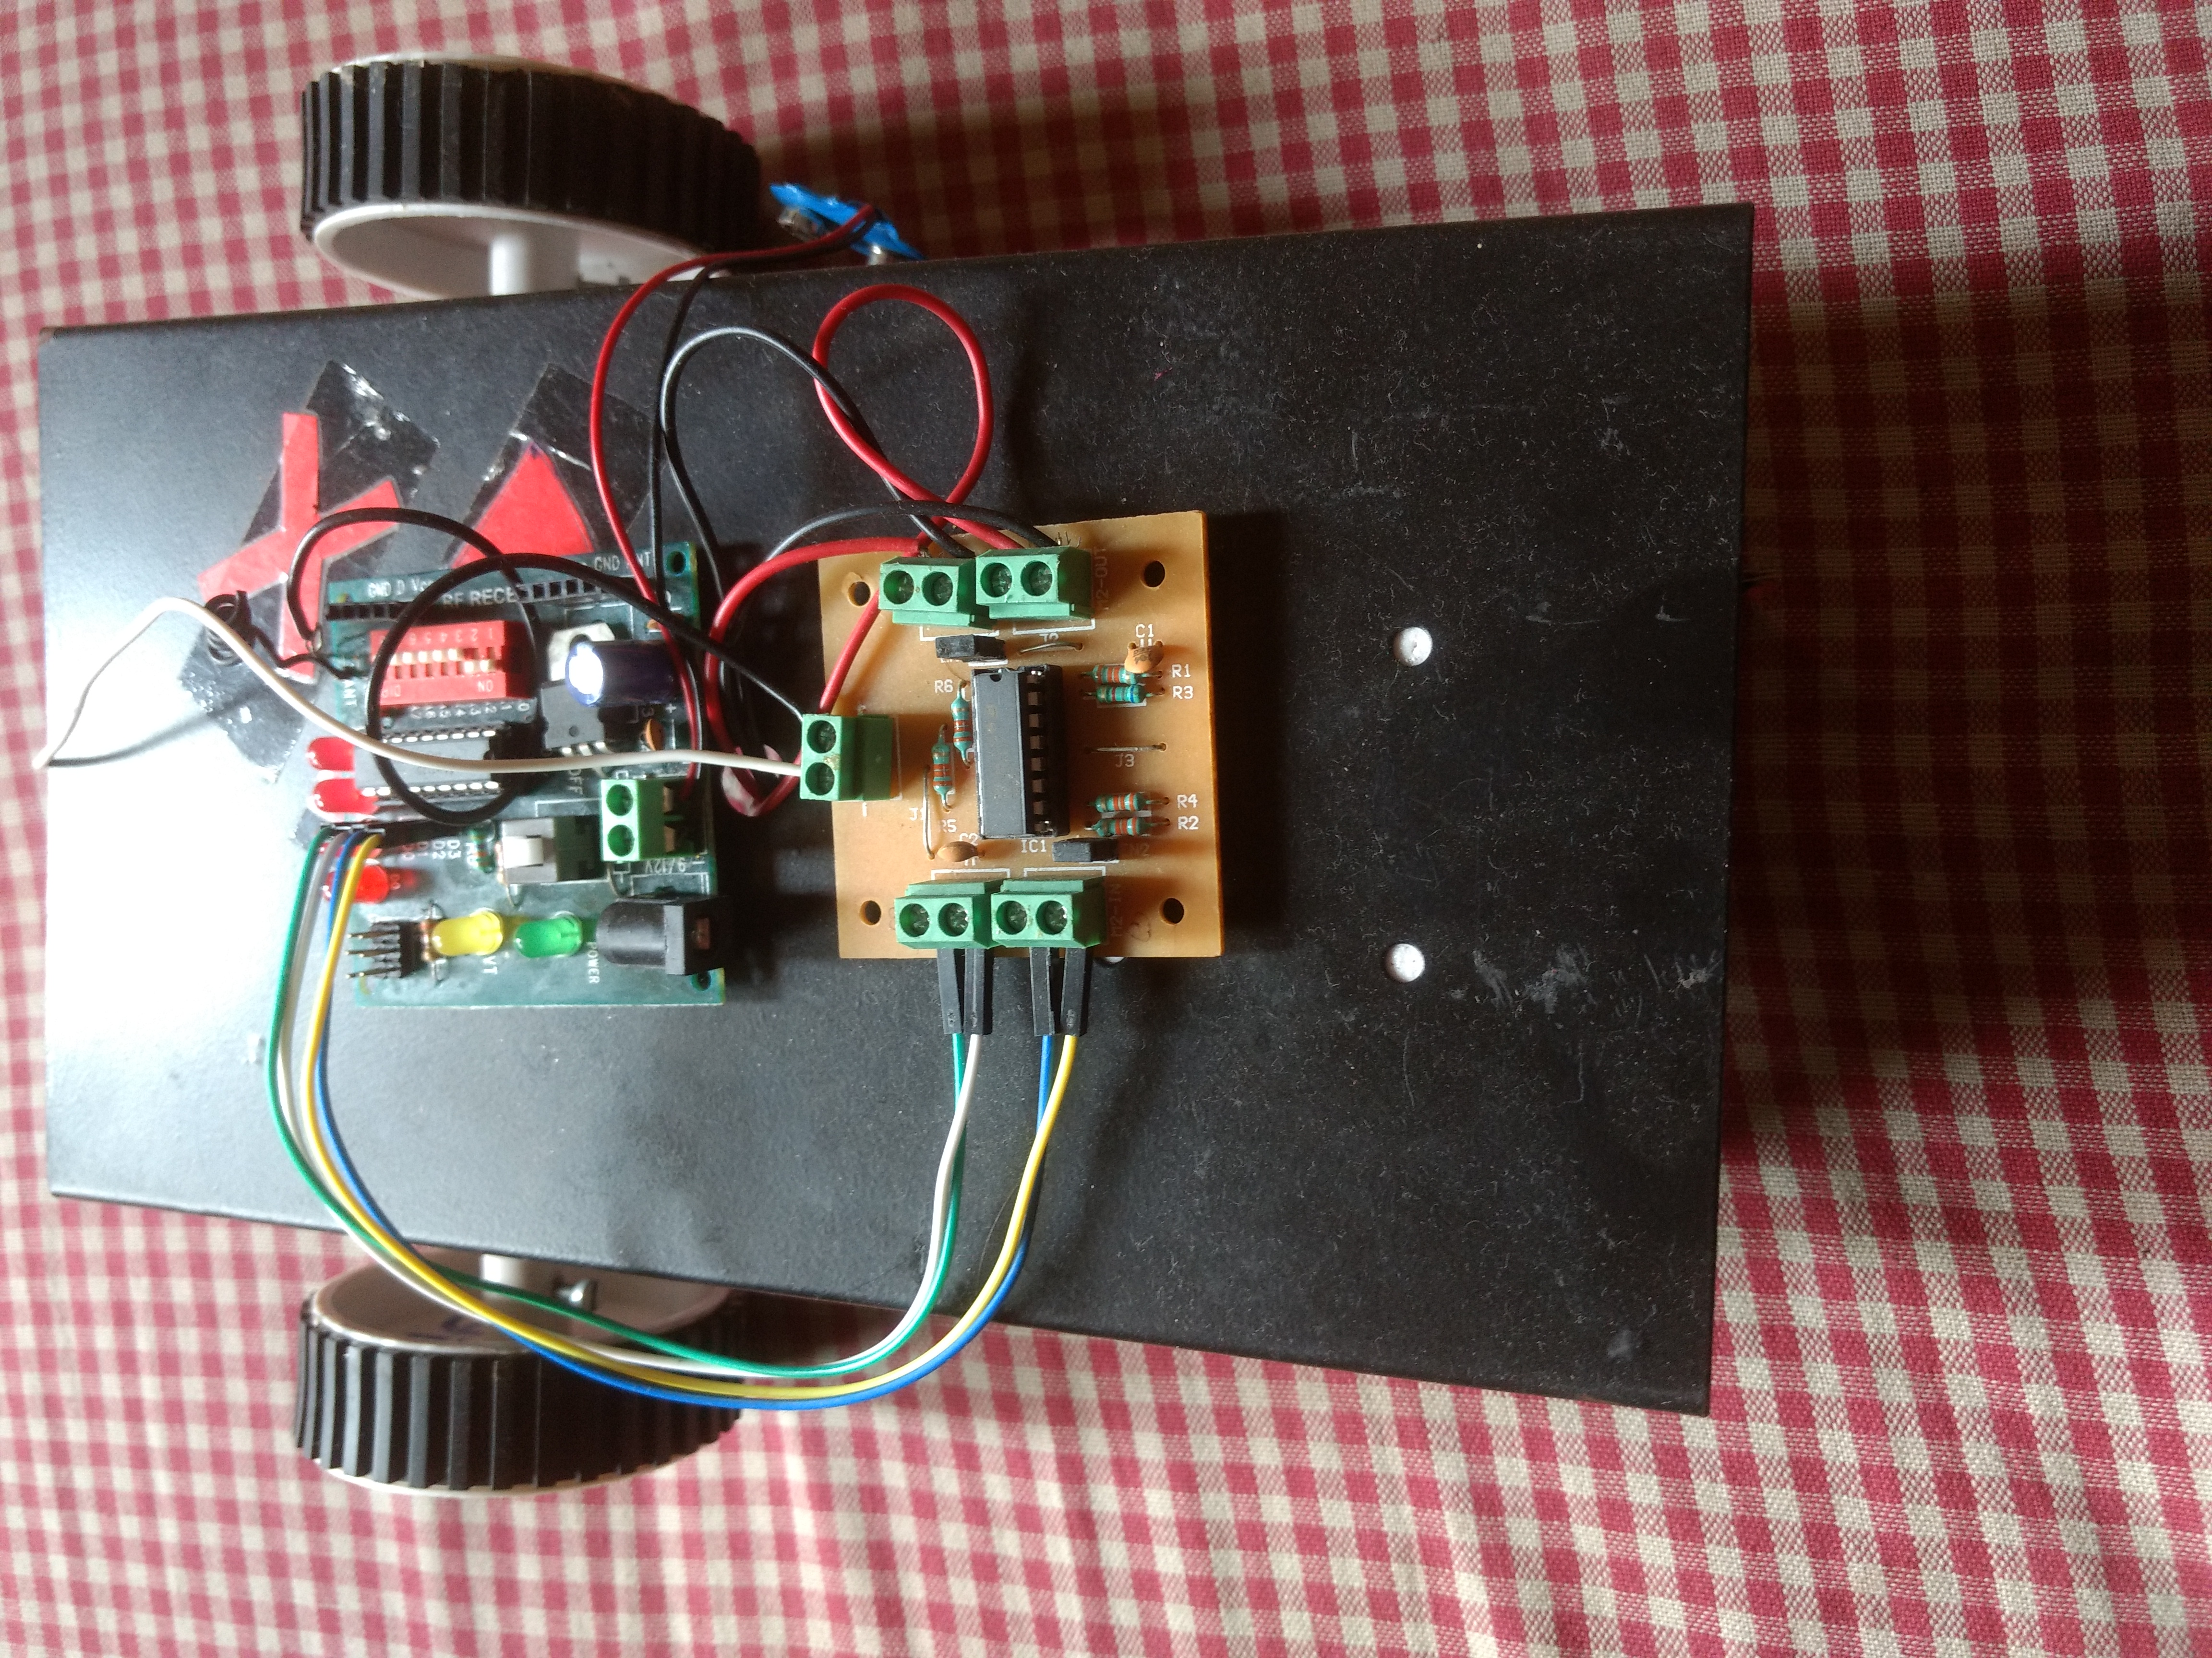
Prototype

Slide 6
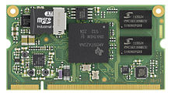
Technology Used
Embedded System
It is a programmed controlling and operating system.
It is a real time computing system.
Wireless Communication

Slide 7

Arduino UNO
The Arduino is an open source microcontroller board based on the Microchip Atmega328P.
It has multiple analog, digital and power pins to run the entire system.
In our project, we have used Arduino to convert analog signals from accelerometer to digital signals which can be used to transmit data.

Slide 8
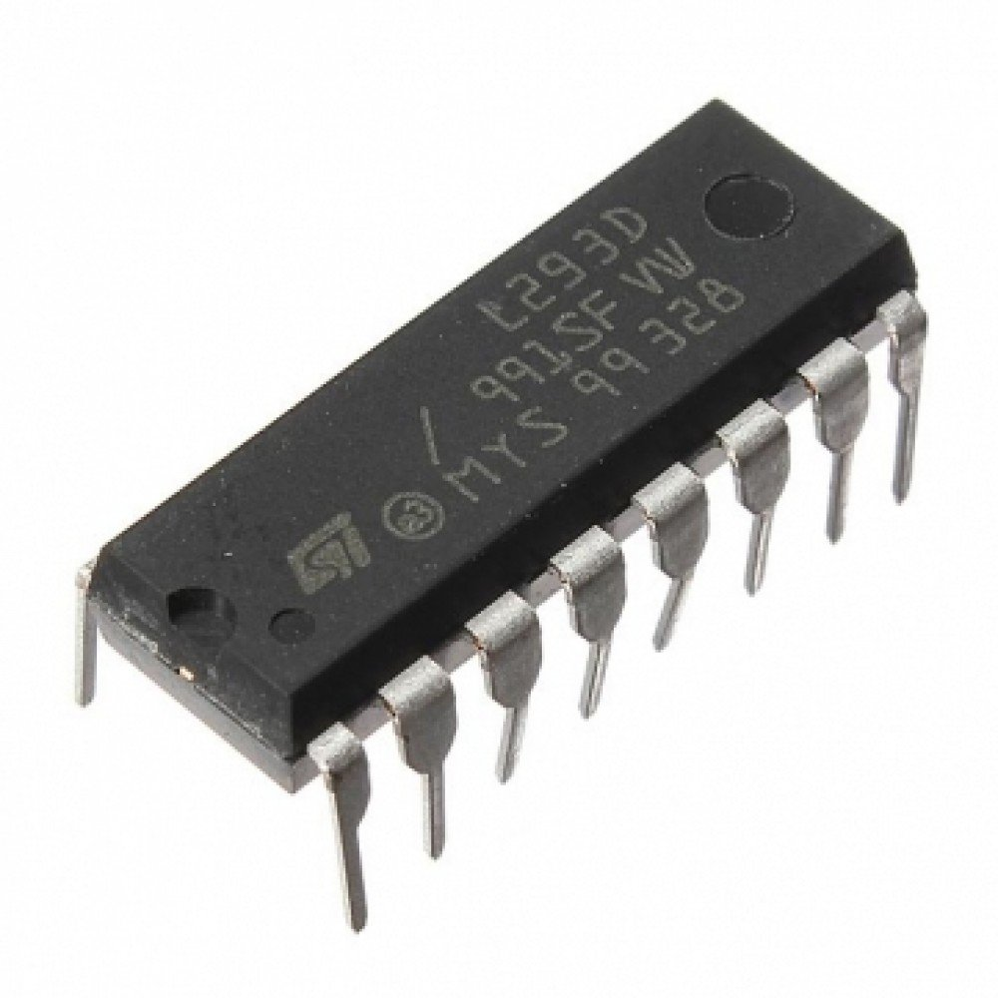
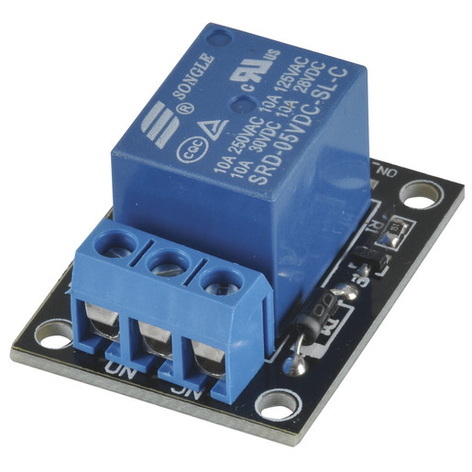
Technology continued...
HT12E is an encoder IC that encodes 4 bit binary signal which is received by the receiver and HT12D decoder IC decodes it back.
L293D IC on receiving the signal gives the signal to relays and then the wheelchair starts moving.

Slide 9
Conclusion
The wheelchair is fully capable of carrying the load up to 110Kg, and moving in accordance to the gesture given by the person who is using the wheel chair.
Certain improvisation and improvement can be done to make the wheelchair more reachable to those whose whole body is paralyzed.

Slide 10
References
Prof. Vishal V. Pande, ”Hand Gesture Based Wheelchair Movement Control for Disabled Person Using MEMS” et al Int. Journal of Engineering Research and Applications Vol. 4, Issue 4( Version 4), April 2014, pp.152-158
Mahaboob Ali Shaik M.Prathyusha, K. S. Roy, “Voice and touch screen based direction and speed control sof wheel chair for physically challenged using arduino,”
Amundson JS, Amundson SG,“A joystick controlled wheelchair”,Biomed Sci Instrum .1991; 27:131-3.

Slide 11
Thank you..
Any Suggestion??

